Slide 1






Foundations of
Quantum Information Science (QIS 102)
Dave Biersach
Brookhaven National Laboratory
dbiersach@bnl.gov
Session 15
Vector Algebra

Slide 2
Session 15 – Goals
Understand 3D axes in matplotlib
Plot Archimedes' Spiral in 3D using cylindrical coordinates
Understand 3D vertices and facets in matplotlib
Plot a 3D wireframe monolith using Cartesian coordinates
Plot a 3D pyramid that conforms with the Golden Ratio
Relate poloidal and toroidal angles in spherical coordinates
Use Numpy to generate the outer product of two vectors
Plot a 3D sphere using only vertices (a scatter plot)
Plot a 3D wireframe and facets of a sphere and torus
Plot the 3D surface plot of a multivariable function

Slide 3
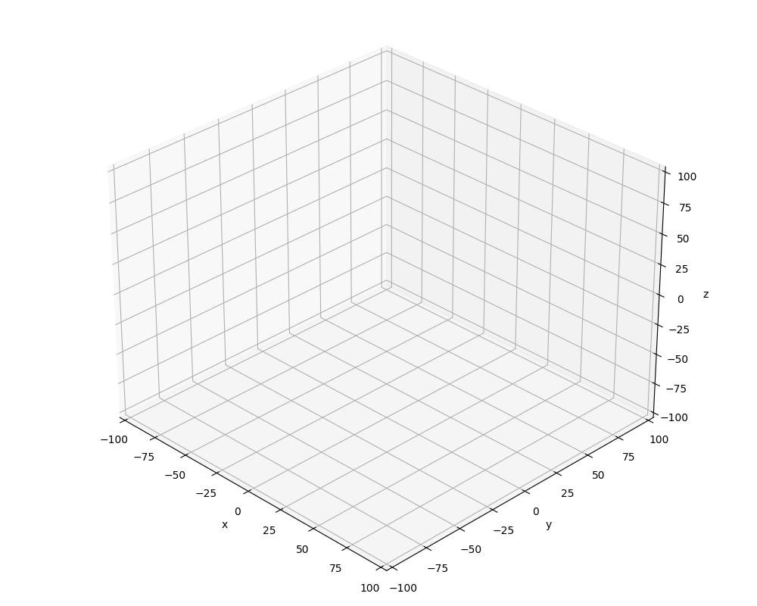
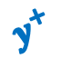


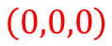
3D Cartesian Coordinates in matplotlib
$$z^{+}$$
$$y^{+}$$
$$z^{+}$$
$$x^{+}$$
$$\left(0,0,0\right)$$
$$y^{+}$$
$$x^{+}$$

Slide 4
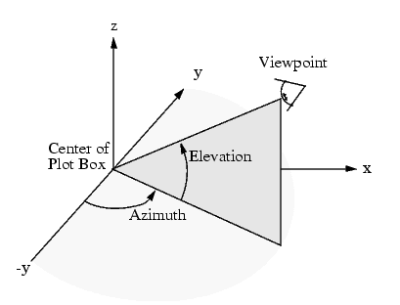
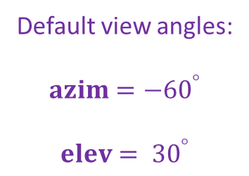
Viewing Angles in matplotlib
Default view angles:
$$azim={−60}^{°}$$
$$elev= {30}^{°}$$

Slide 5
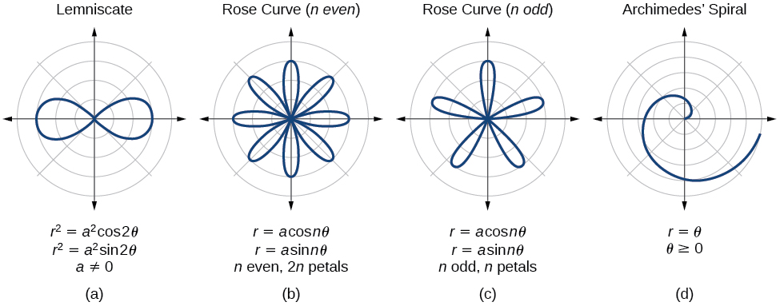
Parametric Curves
The two parameters a, n are used to calculate the current radius $r$ as $θ$sweeps the circle

Slide 6
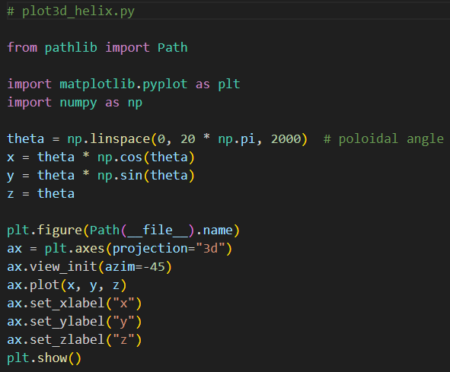
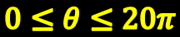

Open plot3d_helix.py
$$\left(θ\cos{θ},θ\sin{θ},θ\right)$$
$$0≤θ≤20π$$
①
②
Cylindrical to Cartesian Coordinate Conversion
③
④
⑤
⑥
Can only set z-axis label on an ax object (not plt)
⑦

Slide 7
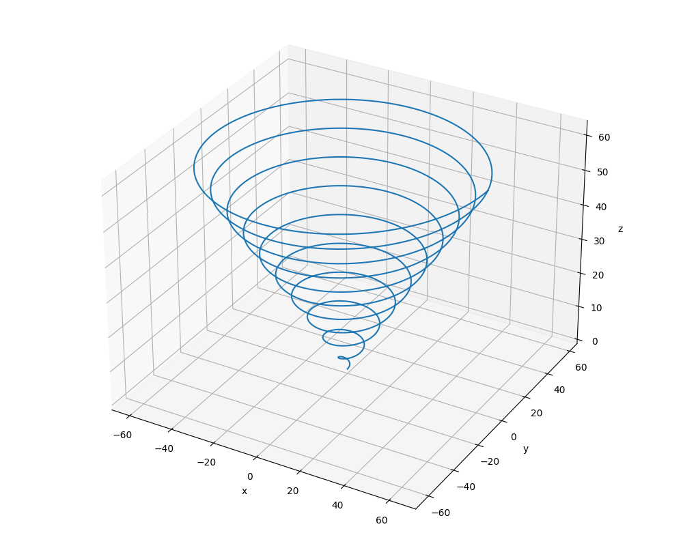
Run plot3d_helix.py
Left-click and drag to rotate the plot
$$\left(θ\cos{θ},θ\sin{θ},θ\right)$$
$$0≤θ≤20π$$

Slide 8
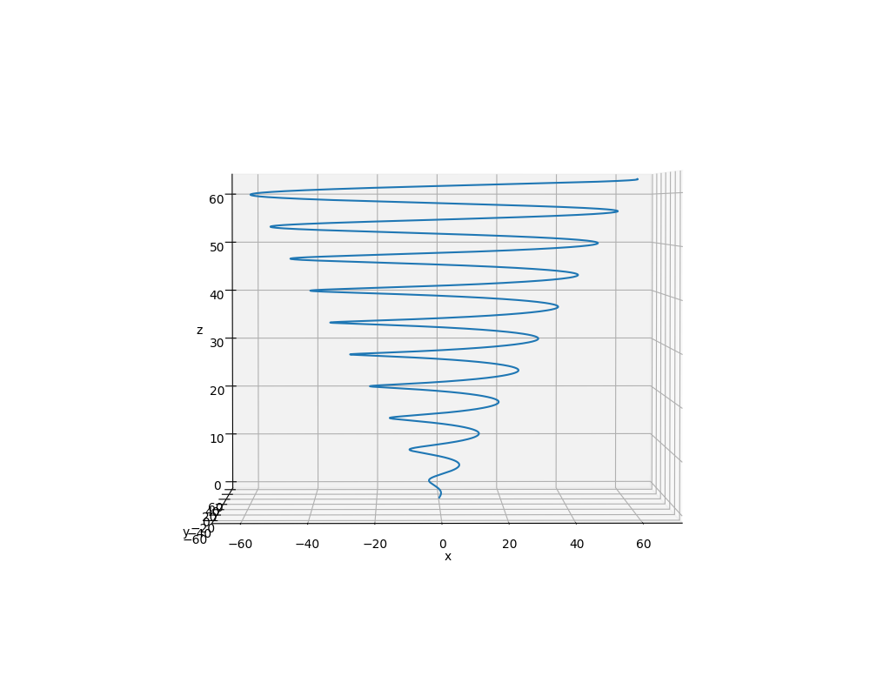
Run plot3d_helix.py
$$z→20π \sim z→62.8$$
$$\left(θ\cos{θ},θ\sin{θ},θ\right)$$
$$0≤θ≤20π$$

Slide 9
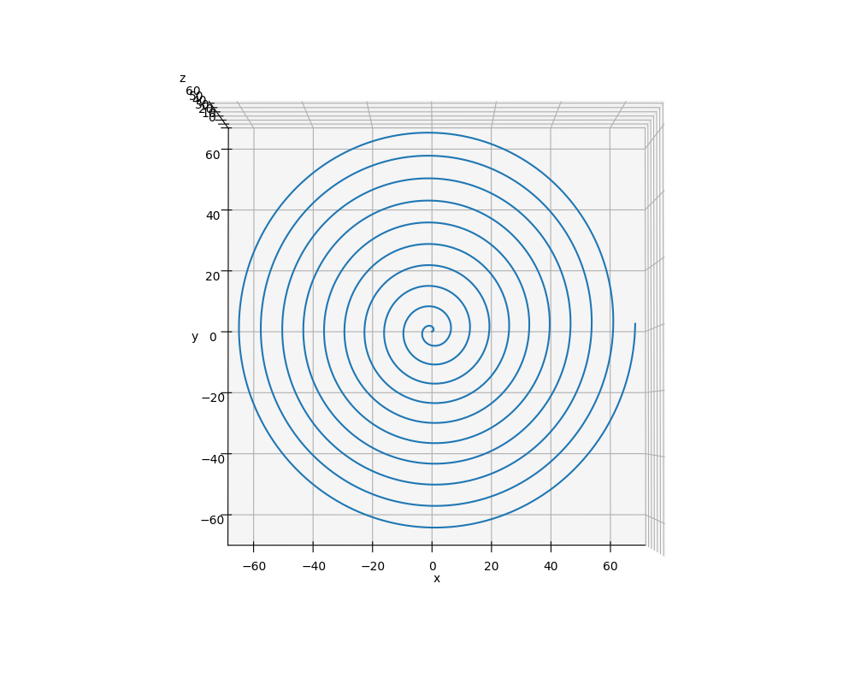
Run plot3d_helix.py
$$x=θ cos{θ}$$
$$y=θ sin{θ}$$
$$0≤θ≤20π$$

Slide 10
3D Axes in matplotlib
Constructing a 3D plot (Cartesian coordinates) using matplotlib can be done using two different approaches:
Define a set of 3D vertices and then manually group these vertices into facets
This approach gives maximal rendering control but is slower
Leverages the capabilities of Poly3DCollection
Provide three arrays containing the $x, y, z$ vertices and then let matplotlib determine how best to connect them
No lines connecting the points = scatter plot
Only lines connecting the points = wireframe
Filled polygons connecting nearby points = surface plot

Slide 11
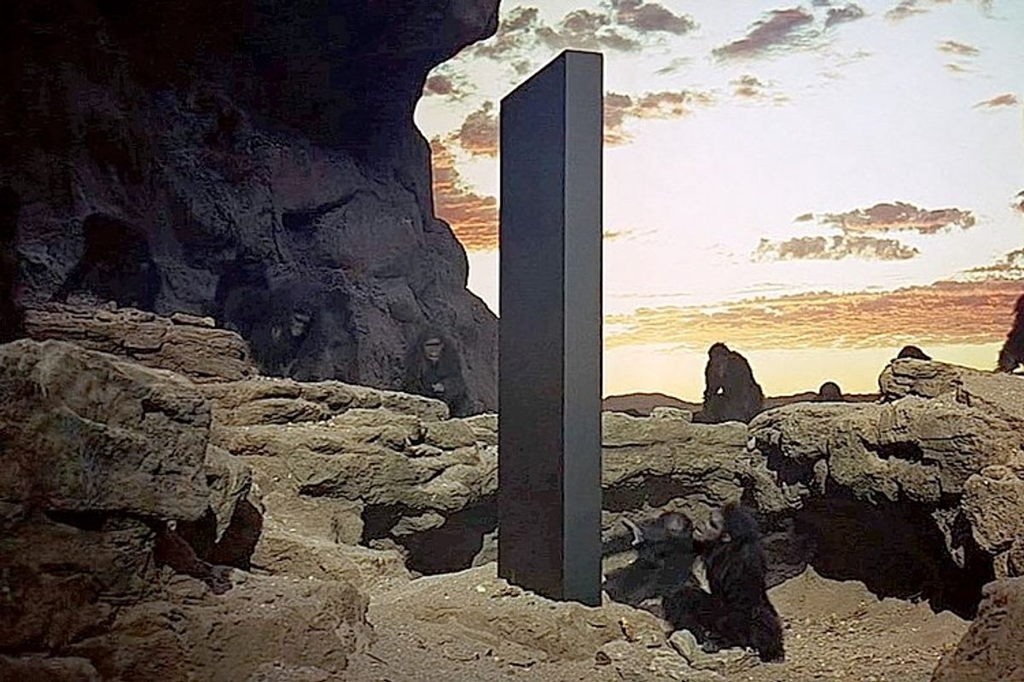
Drawing a Monolith

Slide 12
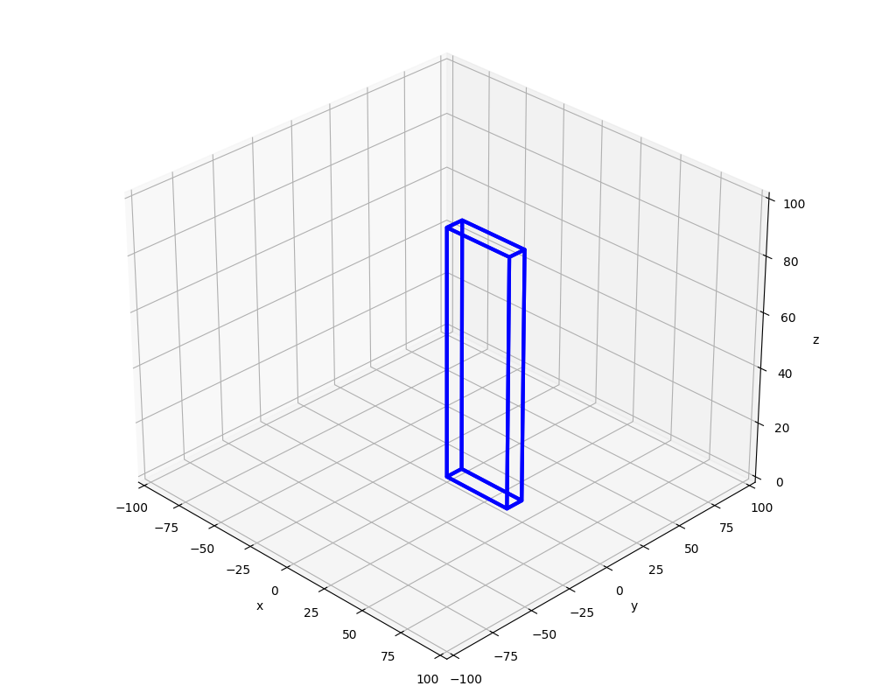
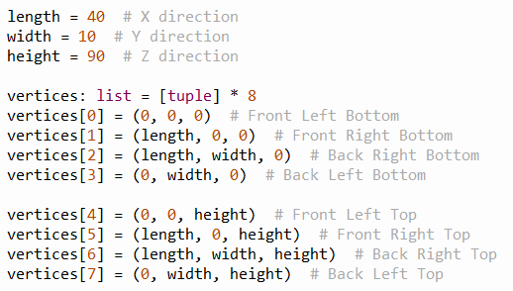
3D Cartesian Coordinates in matplotlib
⑦
④
$$length$$
⑥
⑤
$$height$$
$$length$$
③
$$width$$
⓪
②
①

Slide 13
3D Cartesian Coordinates in matplotlib
①
⑤
②
③
⓪
④

Slide 14
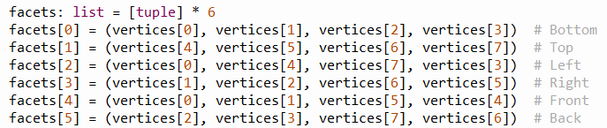
3D Cartesian Coordinates in matplotlib
⑦
④
①
⑥
⑤
⑤
②
③
③
⓪
⓪
②
④
①

Slide 15
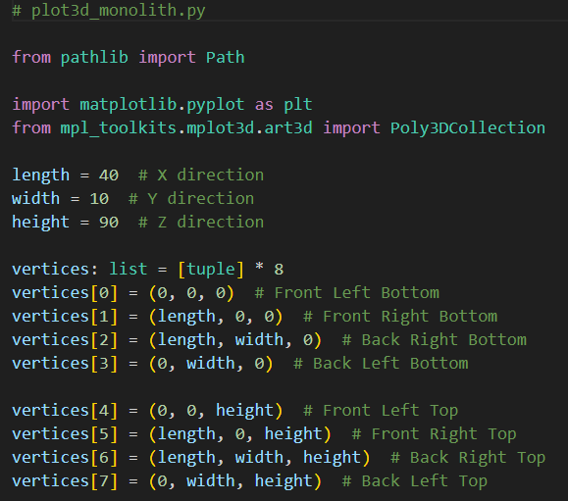
Open plot3d_monolith.py
①
②
③

Slide 16
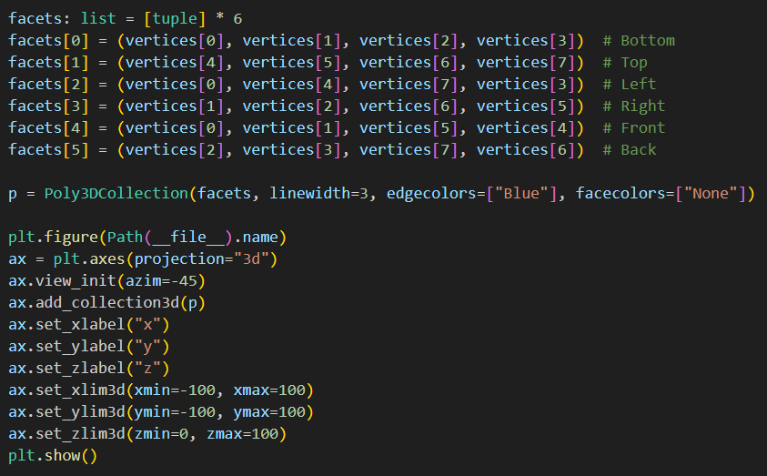
Open plot3d_monolith.py
①
②
③
④

Slide 17
Run plot3d_monolith.py
☺

Slide 18
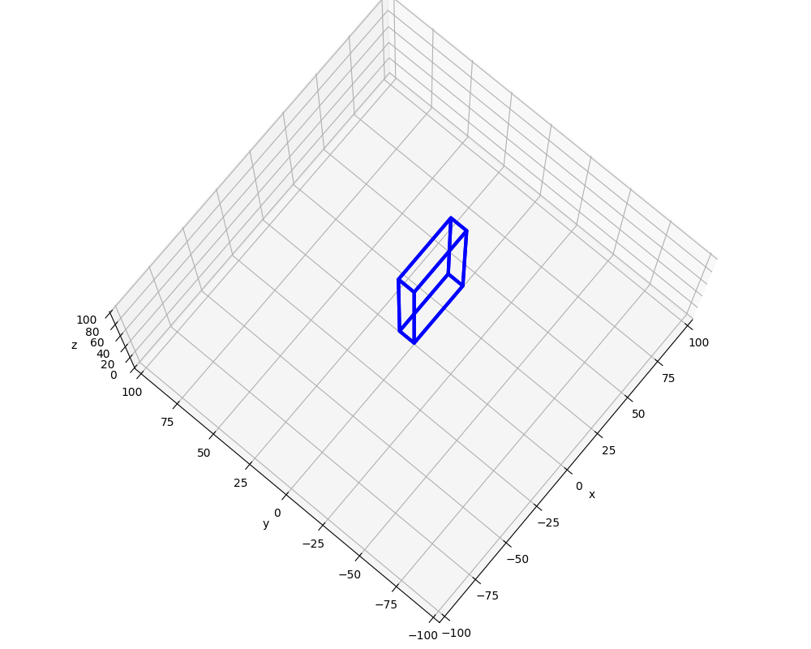
Run plot3d_monolith.py
Left-click and drag to rotate the plot

Slide 19
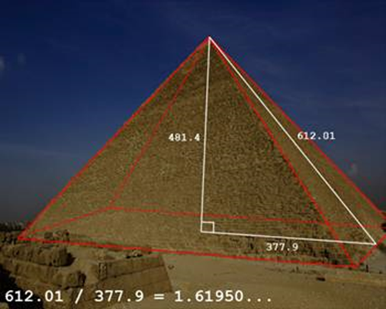
Drawing a Pyramid
Draw a pyramid with $length=width=150$ and $height=length ∗ φ$
lowercase phi

Slide 20
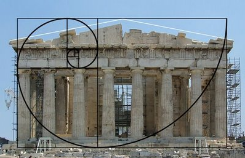

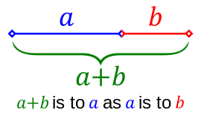
The Golden Ratio
$$1+ \frac{1}{φ}=φ$$
$$φ+1=φ^{2}$$
lowercase
phi
$$\frac{a+b}{a}=\frac{a}{b}=φ$$
$$φ^{2}−φ−1=0$$
$$1+ \frac{b}{a}=\frac{a}{b}=φ$$
$$φ=\frac{1+\sqrt{5}}{2}=1.6180339887…$$

Slide 21
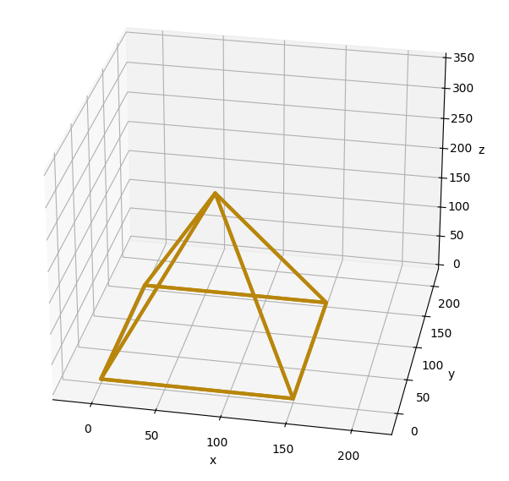
Drawing a Pyramid
④
④
③
①
③
②
⓪
⓪
②
①
$$length=width=150, height=length ∗ φ$$

Slide 22
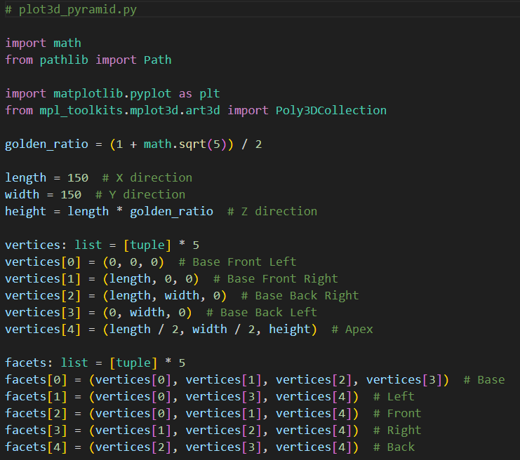
Open plot3d_pyramid.py
①
②
③
④
⑤
⑥

Slide 23
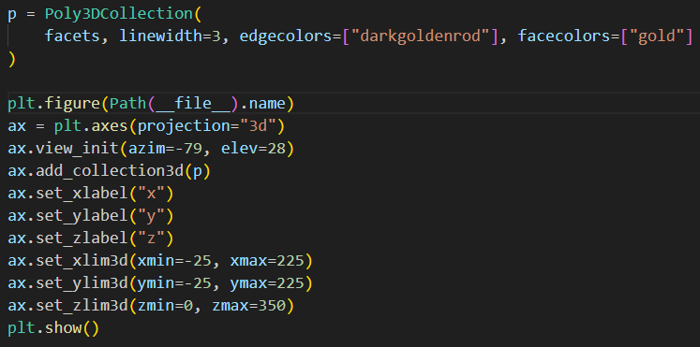
View plot3d_pyramid.py
①
②
③

Slide 24
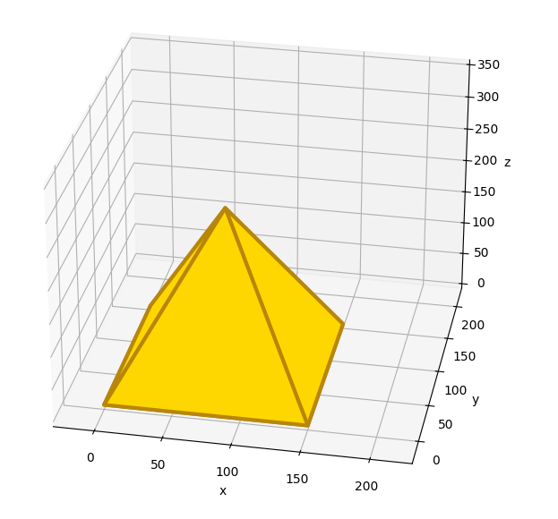
Run plot3d_pyramid.py
☺

Slide 25
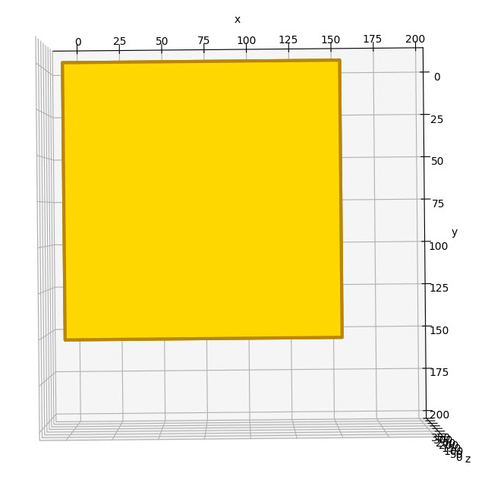
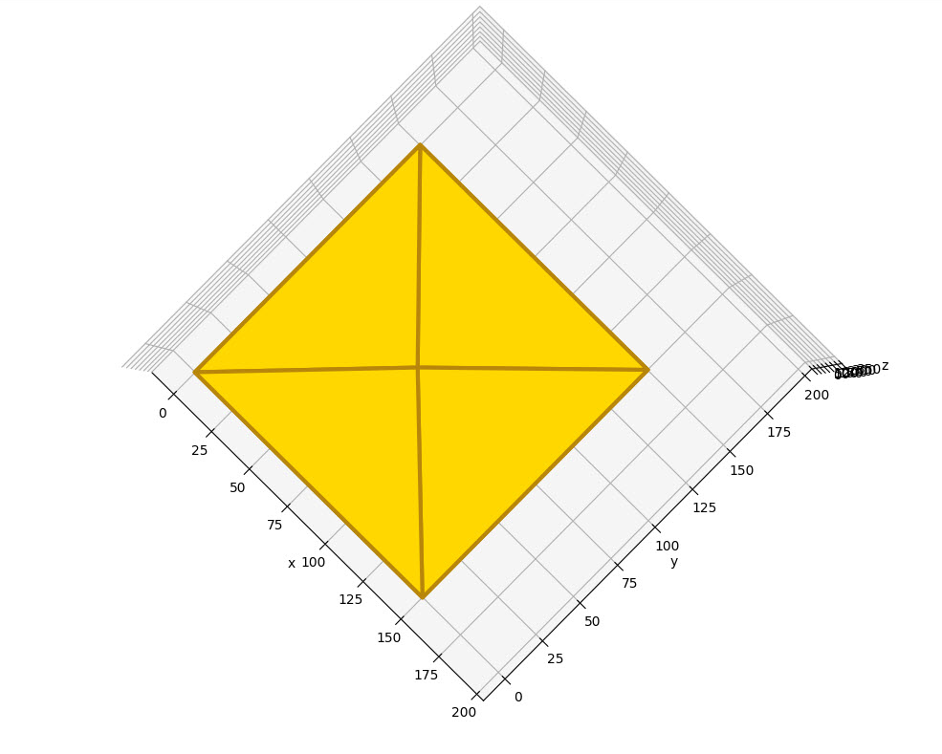
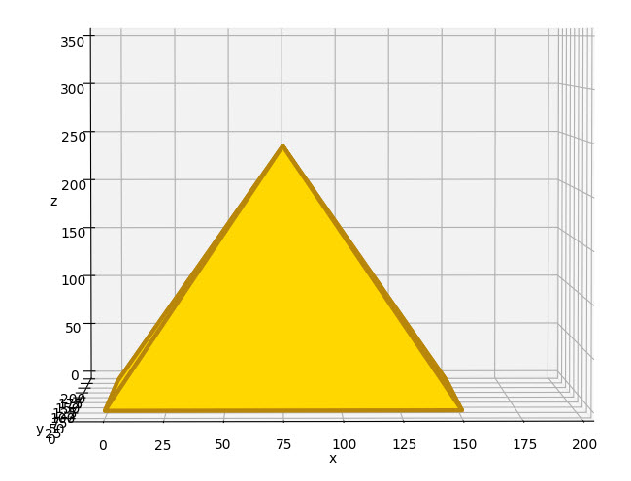
View plot3d_pyramid.py
Left-click and drag to rotate the plot

Slide 26
3D Axes in matplotlib
Constructing a 3D plot (Cartesian coordinates) using matplotlib can be done using two different approaches:
Define a set of 3D vertices and then manually group these vertices into facets
This approach gives maximal rendering control but is slower
Leverages the capabilities of Poly3DCollection
Provide three arrays containing the $x, y, z$ vertices and then let matplotlib determine how best to connect them
No lines connecting the points = scatter plot
Only lines connecting the points = wireframe
Filled polygons connecting nearby points = surface plot

Slide 27
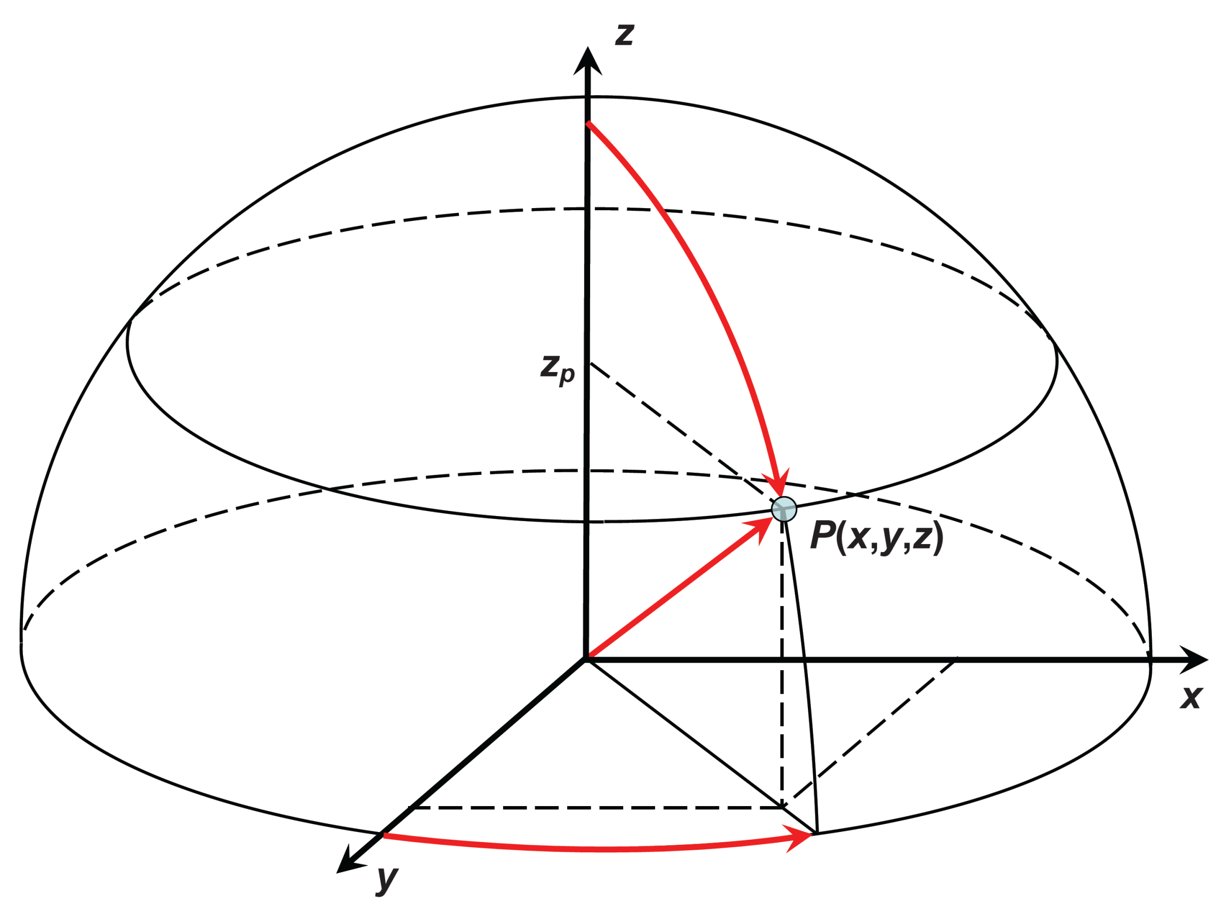
Poloidal and Toroidal Angles
$0≤u≤π⟹$ poloidal (latitude)
North to South Pole (vertical)
$0≤v≤2π⟹$ toroidal (longitude)
Around the slice (horizontal)
$R=$ radius of sphere
$R_{t}$= radius of slice
$$z=R\cos{u}$$
$$x=R_{t}\sin{v}$$
$$R_{t}=R\sin{u}$$
$$y=R_{t}\cos{v}$$
$$z$$
$$x=\sin{u}\sin{v}$$
$$y=\sin{u}\cos{v}$$
$$z=\cos{u}$$
$$R_{t}$$
$$u$$
$$R$$
$$R$$
$$x$$
$$v$$
$$R_{t}$$
For a unit sphere where $R = 1$
$$y$$

Slide 28
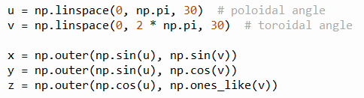
Matrices and Outer Product
$$u=(u_{1},u_{2},⋯,u_{m})$$
$$v=(v_{1},v_{2},⋯,v_{n})$$
$$x=sin{u}⨂\sin{v}$$
$$y=sin{u}⨂\cos{v}$$
$$z=\cos{u}⨂1$$
For a unit sphere where $R = 1$
$$x=\sin{u}\sin{v}$$
$$y=\sin{u}\cos{v}$$
$$z=\cos{u}$$
$$a⨂b=\left[\begin{matrix}\begin{matrix}a_{1}b_{1} & a_{1}b_{2} \\ a_{2}b_{1} & a_{2}b_{2}\end{matrix} & ⋯ & \begin{matrix}ab_{n} \\ a_{2}b_{n}\end{matrix} \\ ⋮ & ⋱ & ⋮ \\ \begin{matrix}a_{m}b_{1} & a_{m}b_{2}\end{matrix} & ⋯ & a_{m}b_{n}\end{matrix}\right]$$
Outer Product of Two Vectors

Slide 29
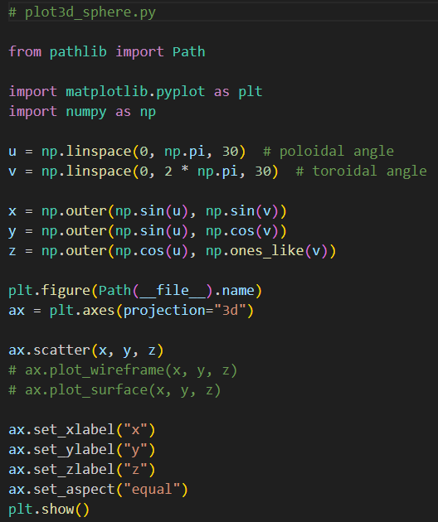
Open plot3d_sphere.py
①
②
③
④
⑤
⑥

Slide 30
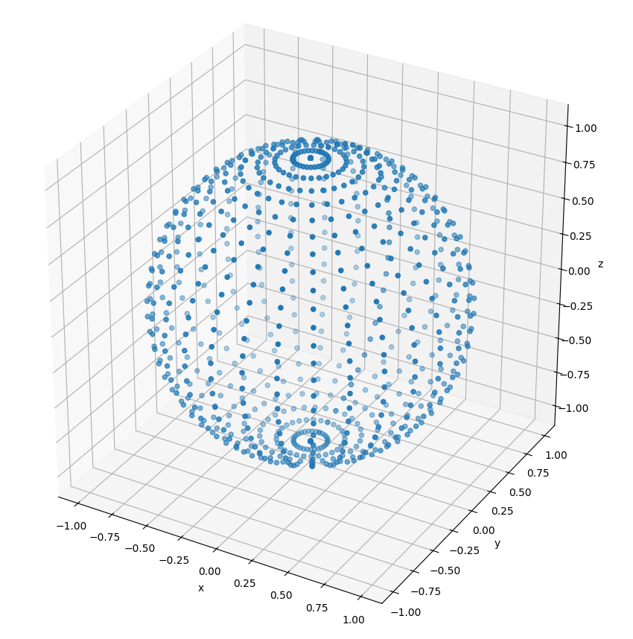
Run plot3d_sphere.py

Slide 31
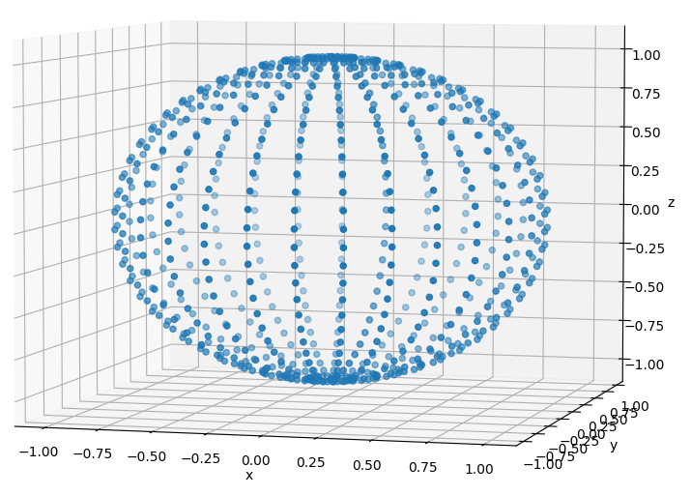
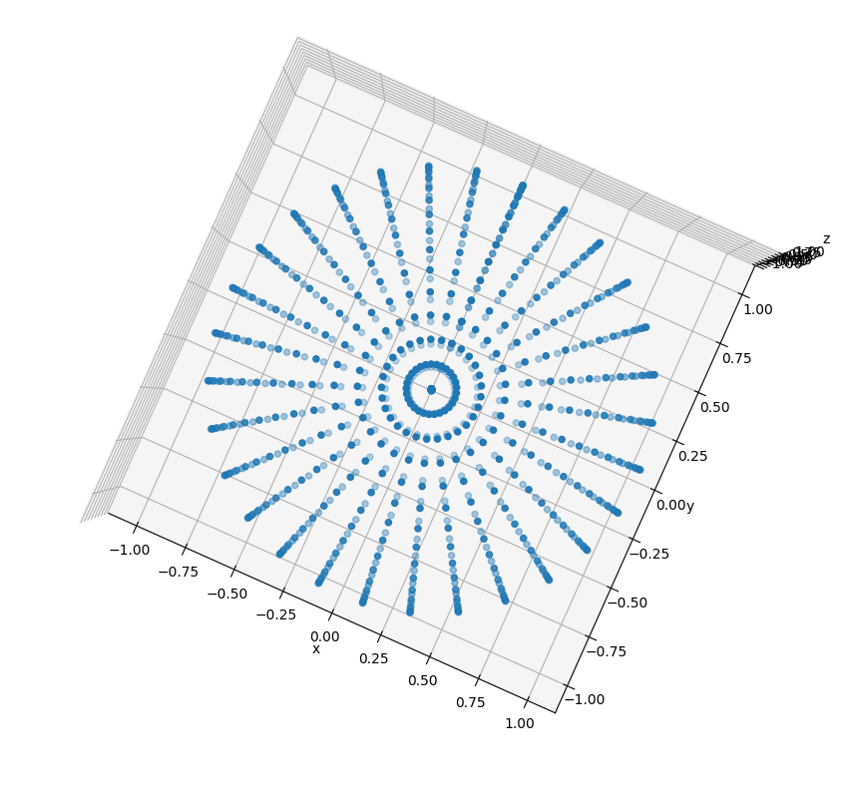

Run plot3d_sphere.py
$0≤v≤2π⟹$ toroidal (longitude)
Around the slice (horizontal)
$$u$$
$$R$$
$R_{t}$= radius of slice
$$v$$
$$R_{t}$$
$0≤u≤π⟹$ poloidal (latitude)
North to South Pole (vertical)

Slide 32
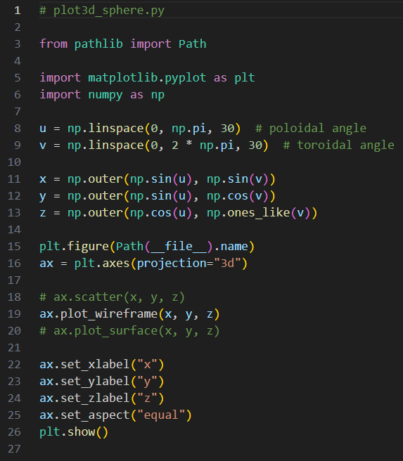
Edit plot3d_sphere.py
Comment out line 18
Uncomment line 19

Slide 33
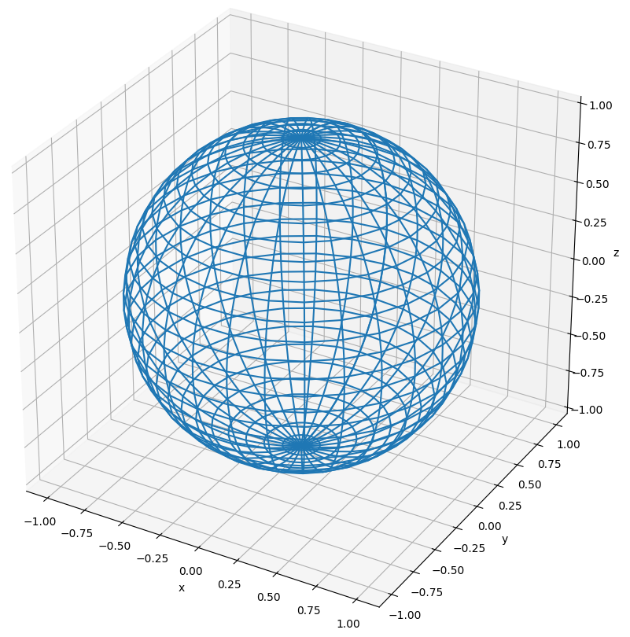
Run plot3d_sphere.py

Slide 34
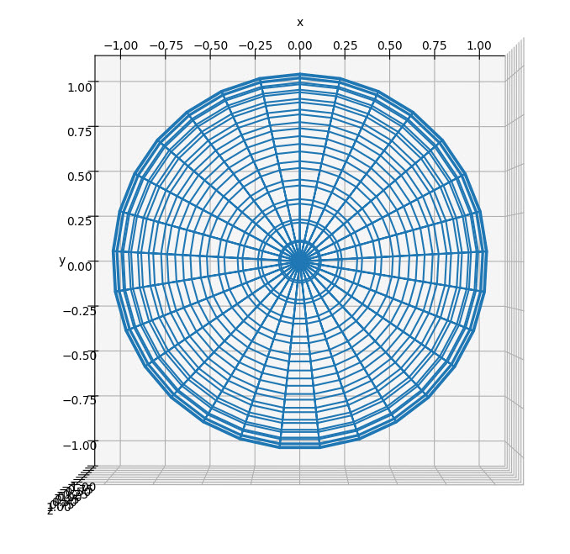
View plot3d_sphere.py
Top-Down
View

Slide 35
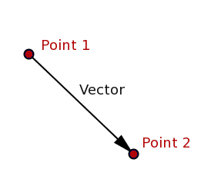
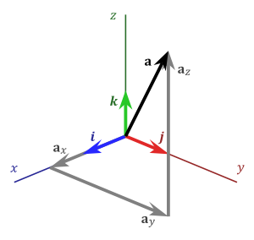
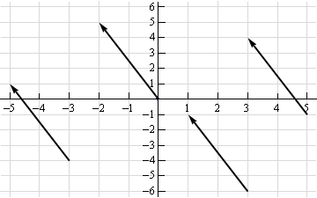
What is a vector?
$a_{x} a_{y} a_{z}$ are the components of
vector$\overset{⃑}{a}$
$$a_{x}={P2}_{x}−{P1}_{x}$$
$$a_{y}={P2}_{y}−{P1}_{y}$$
$$a_{z}={P2}_{z}−{P1}_{z}$$

Slide 36
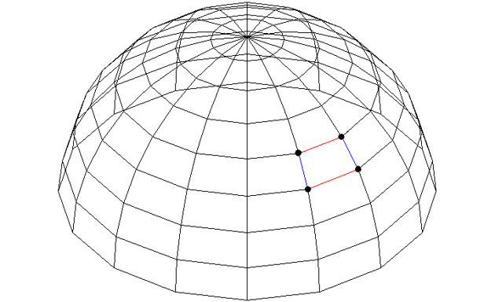
What is a vector?
How do we avoid drawing the facets which are on the back of the sphere?
$$\overset{⃑}{a}$$
⓿
❶
$$\overset{⃑}{b}$$
❷

Slide 37
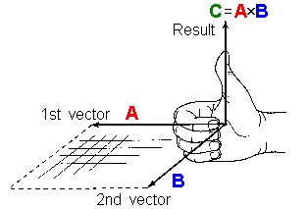
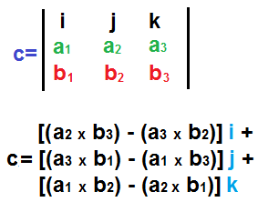
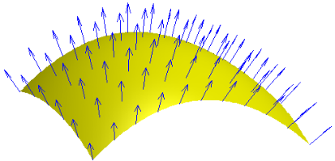
Vector Cross Product
The cross product of two vectors is another vector which is perpendicular to both vectors A and B

Slide 38
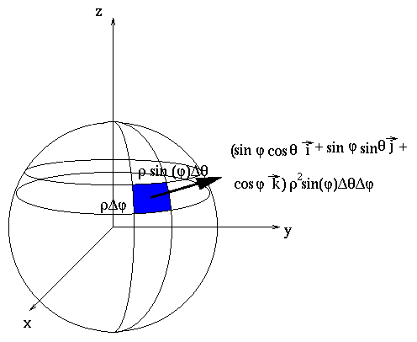
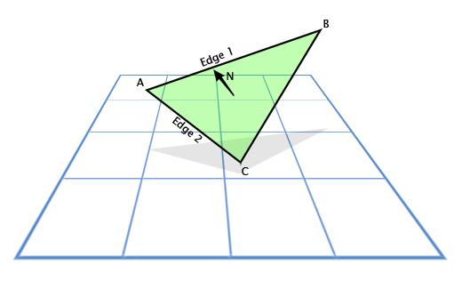
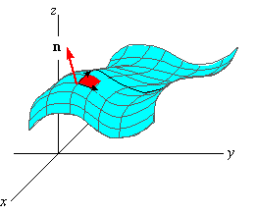
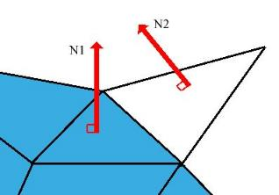
Every Facet has a Surface Normal Vector

Slide 39
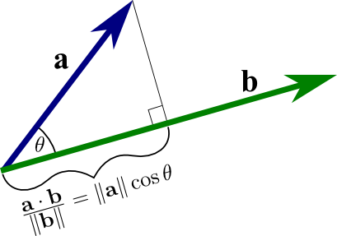
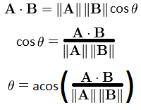
Vector Dot Product
The dot product gives the angle between two vectors

Slide 40




Back Face Culling and Facet Shading
$$\vec{n}$$
Camera / Eye Location
$$θ$$

Slide 41

Edit plot3d_sphere.py
Comment out line 19
Uncomment line 20

Slide 42

Run plot3d_sphere.py
Left-click and drag to rotate the plot

Slide 43

Run plot3d_sphere.py

Slide 44


Modelling a Torus
Your scientist would like to begin modelling the electromagnetic field around a toroidal coil carrying AC current
The first step will be defining and drawing a 3D torus using a modified version of the spherical coordinate system
The red arrow points in the poloidal direction and the blue arrow points in the toroidal direction
A sphere and a torus are not homeomorphic: unlike a sphere, a torus needs two radii to fully describe it

Slide 45

Modelling a Torus
Note: $0≤u≤2π$
$$R_{t}=Radius of Torus$$
$$R_{c}=Radius of Cross Section$$
$$u$$
$$(z)$$
$$R_{c}$$
$$R_{t}$$
$$x=\left[R_{t}+R_{c}\sin{u}\right]\cos{v}$$
$$y=\left[R_{t}+R_{c}\sin{u}\right]\sin{v}$$
$$z=R_{c}\cos{u}$$

Slide 46

Modelling a Torus
Note: $0≤u≤2π$
$$(x,y)$$
$$v$$
$$R_{t}$$
$$R_{c}$$
$$x=\left[R_{t}+R_{c}\sin{u}\right]\cos{v}$$
$$y=\left[R_{t}+R_{c}\sin{u}\right]\sin{v}$$
$$z=R_{c}\cos{u}$$

Slide 47

Open plot3d_torus.py
①
②
③
④
⑤
⑥
⑦

Slide 48

Run plot3d_torus.py

Slide 49

Edit plot3d_torus.py
Comment out line 22
rcount = Max # rows
ccount = Max # cols
①
Uncomment line 23

Slide 50

Run plot3d_torus.py

Slide 51


Open plot3d_surface.py
①
$$f\left(x,y\right)=\sin\left(\sqrt{x^{2}+y^{2}}\right)$$
②
③
NumPy Meshgrid From Zero To Hero
④
⑤
⑥
⑦
⑧
10 total tick marks, linearly spaced

Slide 52


Run plot3d_surface.py
$$f\left(x,y\right)=\sin\left(\sqrt{x^{2}+y^{2}}\right)$$

Slide 53


View plot3d_surface.py

Slide 54

The Gradient Operator
A differential operator
Scalar Field → Vector Field
Vector Field → Scalar Field
Vector Field → Vector Field

Slide 55

The Gradient Operator
Direction of steepest ascent
The gradient, represented by the blue arrows, denotes the direction of the most positive change in a scalar field

Slide 56

The Gradient Operator
https://numpy.org/doc/stable/reference/generated/numpy.gradient.html

Slide 57



Open plot3d_gradient.py
①
$$f\left(x,y\right)=\sin\left(\sqrt{x^{2}+y^{2}}\right)$$
We only want gradient arrows drawn every 5 data points on the fine grid
②
③
④
⑤
⑥
⑦
⑧
⑨
⑩
Derivatives are rise over run $=\frac{∂y}{∂x}$ so the $ⅆy$ vector is returned first in the tuple

Slide 58

Run plot3d_gradient.py
Direction of steepest ascent
How does the 2nd derivative of the function affect the length of the quivers?

Slide 59
Session 15 – Now You Know…
How to draw 3D images with matplotlib
How to create vertices and facets to manually build wireframe and surface plots
How to create vectors of 3D coordinates using radial angles and outer products and then letting matplotlib automatically connect nearby vertices, so it can render wireframes and surface plots
Vector algebra, including inner (dot) product and cross product, can be used to enable back-face culling and facet shading
Two shapes that are not homeomorphic may require additions to the parametric equations (inserting another radius or tracking another angular measure) such as drawing a torus vs. a sphere

Slide 60

Task 15-01
Update the Python file called plot3d_cylinder.py that uses matplotlib to draw a shaded red cylinder of radius 10 and height 50
The cylinder should be aligned along the z-axis
Upload your solution to your folder in BNL QIS102 SharePoint site

Slide 61


Task 15-02
Create a Python file called plot3d_complex_sine.py that uses matplotlib to draw the surface in $ℂ$ given by $f\left(z\right)=\left|\sin\left(z\right)\right|$ over the region $\left(±2.5±i\right)$
Upload your solution to the BNL QIS102 SharePoint site

